Slide 1
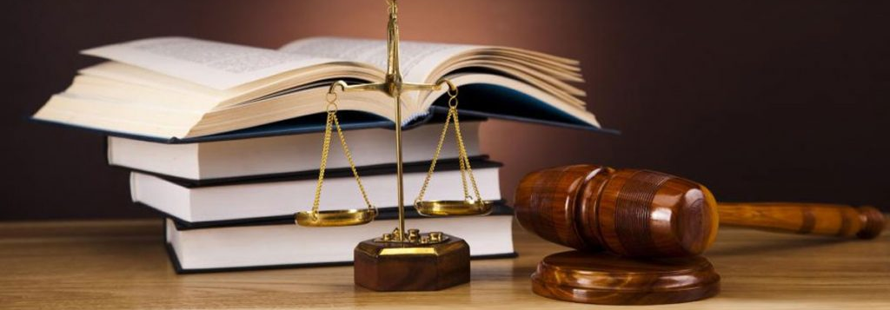
CIVIL AND CRIMINAL TRIAL PROCEDURE
Pre-trial, Trial, Post-trial

Slide 2
PLAN FOR THE NEXT 2 WEEKS...
CRIMINAL
Pre-Trial
Trial
Post-Trial
CIVIL
Post-Trial
Note: when examining the civil and criminal trial procedure, it is important to consider the following ideas:
What is the significance of each stage?
What is the most important stage?
Consider the threshold of each and how that impacts this process.

Slide 3
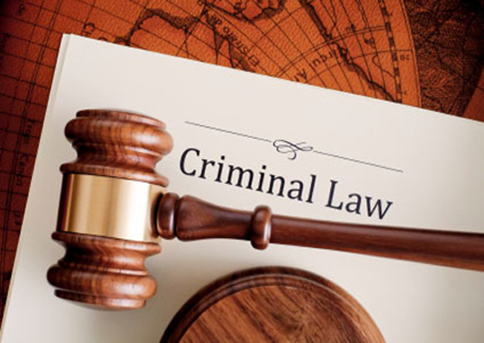

Slide 4
Pre-trial procedure
CRIMINAL

Slide 5
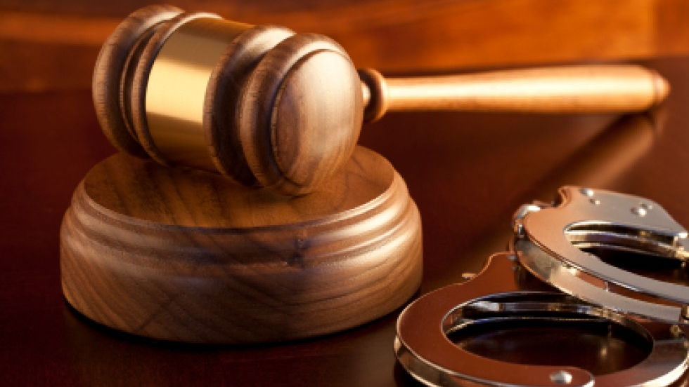
CRIMINAL PRE-TRIAL PROCEDURE
Purpose of criminal pre-trial procedure:
Assist police
Protect the rights of the accused
Provide rights to the police; peoples names, addresses e.t.c.
Provide an opportunity for the accused to be released pending trial
Determine whether a trial should proceed
Allow accused to plead guilty or not guilty
So, first thing to work out…what type of offence are we dealing with? As that will determine pre-trial procedure.
Note: There must have been a criminal act committed

Slide 6
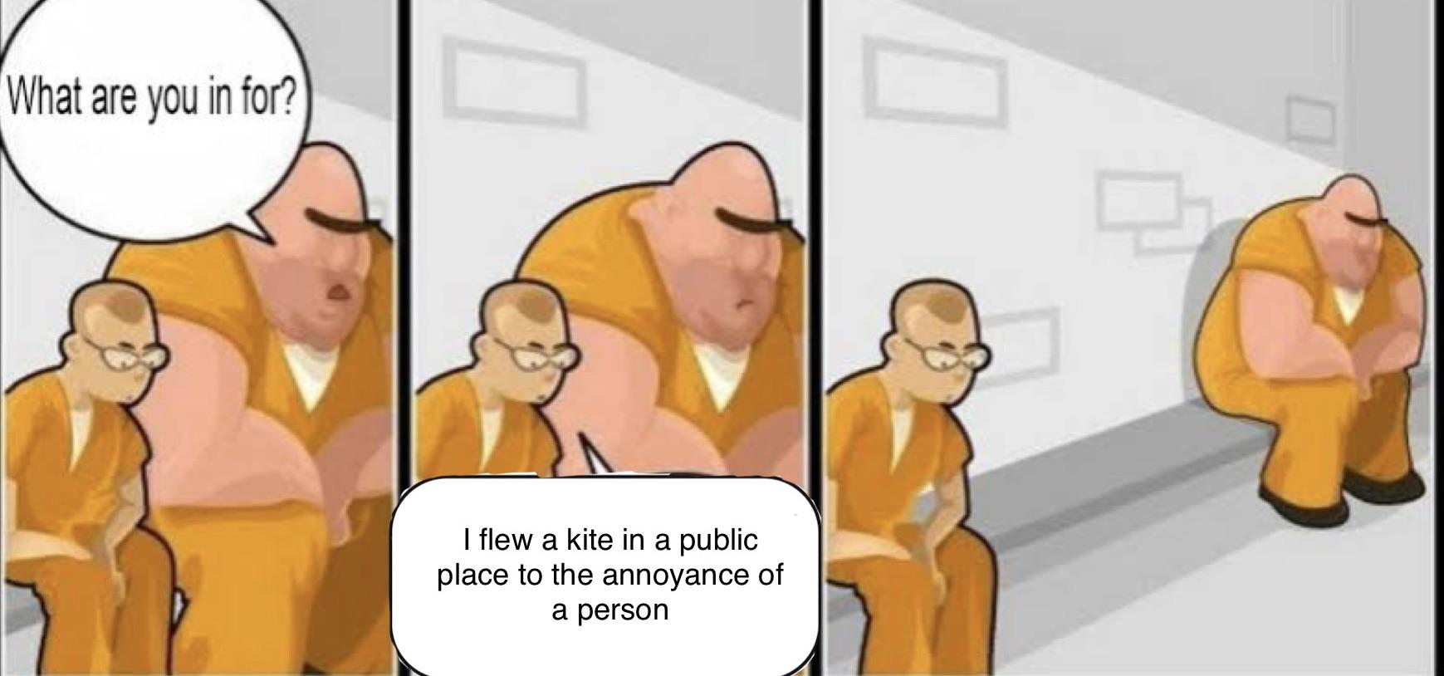
SUMMARY AND INDICTABLE OFFENCES
Summary
Minor or simple offence
Indictable
Serious offence that threatens our fundamental rights
Examples of each?

Slide 7
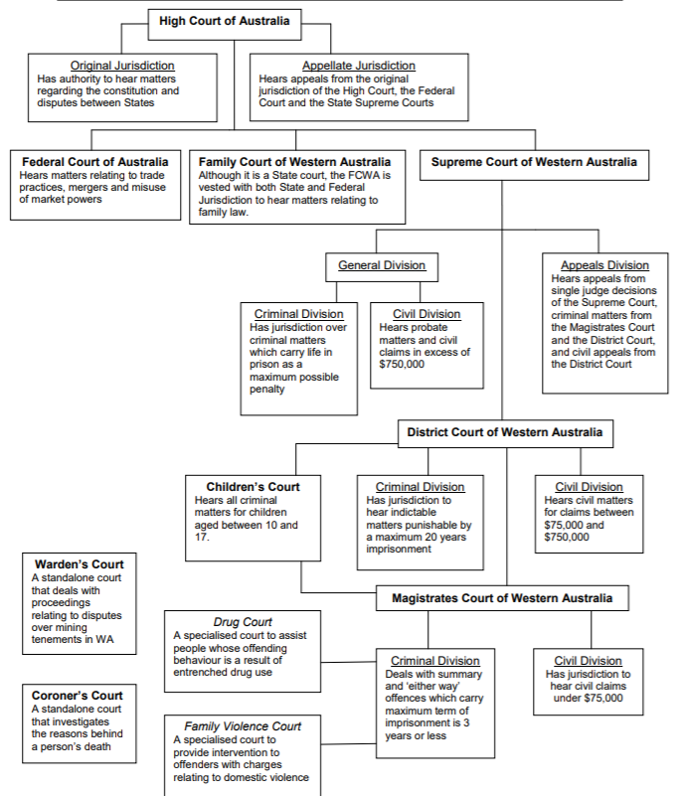
Court hierarchy

Slide 8
Reporting, investigation and arrest
In adversarial system, the police have prime responsibility for administering the pre-trial stage of criminal law
Once a crime is reported (victims, witnesses, police witness) the police can initiate an investigation – the accumulation of evidence:
Material evidence = items used in the offence, DNA, witness statements
A Search warrant can be issued by a magistrate (exceptions – terrorism or witness to indictable offence)
Carrying out surveillance
Police can arrest a person they reasonably suspect has broken the law, their rights must be read
Once police acquire sufficient evidence to meet he standard of proof they will formally begin criminal proceedings, an arrest symbolises the end of the investigation an start of prosecution
Note: investigations cannot infringe on a citizens rights and so are restricted by common law and statutory rules covering matters such as searching and seizure of property, interview times and how evidence is obtained.
Note: A summons my be issued which requires accused to attend court, if they fail to do so they may then be arrested.

Slide 9
CRIMINAL PRE-TRIAL PROCEDURE for SUMMARY OFFENCES
Arrest, usually no warrant required
Charged, filed with Magistrates Court
Magistrates Court issues Criminal Summons
The nature of the alleged crime
When and where case heard
Served on the accused

Slide 10
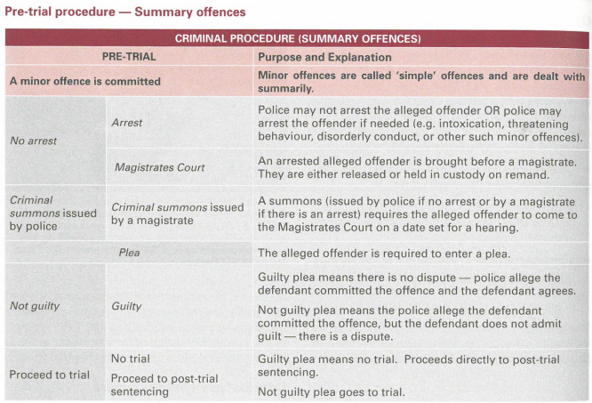

Slide 11
CRIMINAL PRE-TRIAL PROCEDURE for indictable OFFENCES
Majority of arrests require warrants
Brought before Magistrates Court immediately
Advised of charges - Statement of material facts – summary of allegations
Enter plea
Committal for Sentence (guilty) or Committal Mention (not guilty)
Accused is entitled to apply for bail
Magistrates decision whether to grant bail or remand in custody until brought to trial…

Slide 12
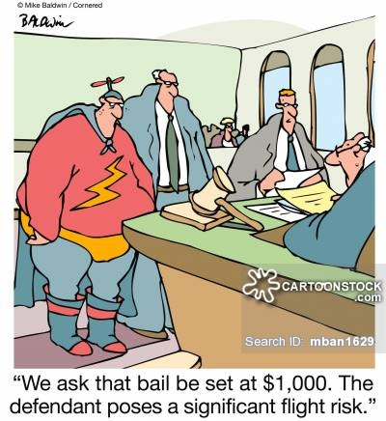
BAIL AND REMAND
Purpose of bail:
To allow an accused person to go free until the hearing or trial
It upholds the presumption of innocence – innocent until proven guilty
Bail is usually granted unless:
Flight risk
Danger to society
In custody for another offence
Bail may involve a deposit of money

Slide 13
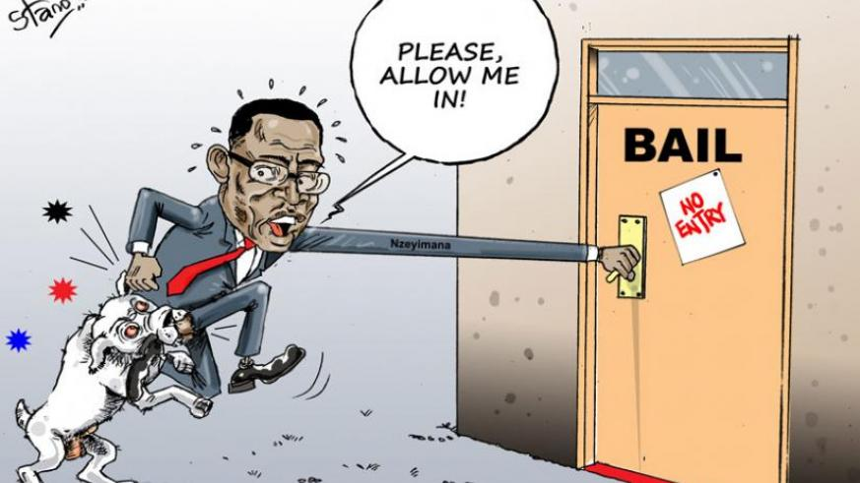
BAIL AND REMAND
Purpose of remand:
To protect the community against the actions of an accused person the court believes may:
Re-offend;
Inflict harm on others;
Commit further crimes; or
Fail to appear before the court for justice to be served
The application of bail conditions and the decision to/not to refuse bail, and remand an accused into custody is considered one of the most important stages if the criminal procedure given the consequences it implies on the individual
It does not dilute presumption of innocence
Whether or not the accused is placed on bail or remanded they will be faced with a committal mention before a magistrate…

Slide 14
Committal mention
Procedure:
Before the CM, the police are required to disclose all material evidence to the accused
Judge examines the ‘hand-in brief’ of evidence
Written evidence, witness statements e.t.c
Can hear oral testimony if necessary, tend to be avoided as to speed up committal hearing process
Accused enters a plea
Judge decides whether there is enough evidence to go to trial, if the police have insufficient evidence to convict the accused, the case will be thrown out at the committal hearing
The prosecution will put all the evidence together such as witness statements; photos; forensic evidence e.t.c – preparation time for trial

Slide 15
Committal mention
Procedure:
If prima facie case (upon initial examination, sufficient corroborating evidence appears to exist to support a case) is established and judge decides to go to court;
Accused is committed to trial in a superior court
Released on bail or held in remand
Prosecution is required to provide full disclosure of their case
Application for indictable offence to be heard by judge alone, note: this is rare as WA criminal law prescribes that certain indictable offences must be heard before a judge and jury in senior courts i.e. murder in Supreme Court

Slide 16
Other pre-trial procedure for indictable offence
Plea Hearing
The formal charges are put to the accused and the plea is entered
Sentencing or status conference (not guilty)
Status Conference
This is used to ensure there is readiness for trial
Set trial date that is suitable for all
The judge will set this date and estimate length of trial
Direction Hearing
Look at legal issues that need to be decided before the trial i.e. admissibility of evidence

Slide 17
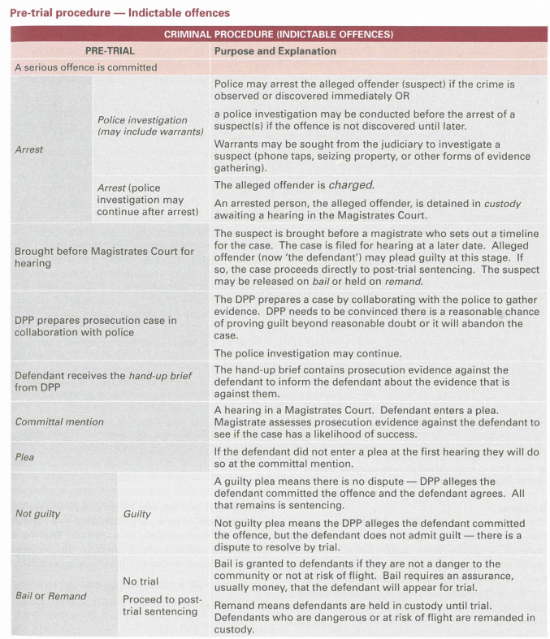

Slide 18
Criminal law – Pre-trial procedures
Stage | Purpose
Directions hearing | Magistrate determines any legal issues that need to be decided upon. Timeline for pre-trial hearings determined
Hand-up brief | Given to the accused and contains DPP’s evidence against them
Committal mention | accused receives witness statements and exhibits. accused may choose to cross-examine the DPP’s witnesses to clarify evidence (contested committal mention)
Committal hearing | DPP presents case to the magistrate, including written statements, prosecution evidence and interview transcripts for the magistrate to determine whether it is likely to succeed and achieve a prosecution (prima facie case)
Plea | If the accused didn’t enter their plea (guilty or not guilty) earlier they may do it during committal proceedings

Slide 19
Evaluation of Pre-trial proceedings
Strengths | Weaknesses
Filters out weak cases which won’t be sent to trial | Complicated process and can be unfair for an unrepresented party
Allows the accused to be informed of the prosecutor’s case against them | Can be expensive
Onus is on the prosecutor to establish enough evidence (prima facie case) | Can add to delays
May result in withdrawal or combination of charges | Can contribute to stress and inconvenience of accused, victims and families
Gives the accused the opportunity to test the strength of the prosecutor’s case | May be considered unnecessary for stronger cases

Slide 20
trial procedure
CRIMINAL

Slide 21
OVERVIEW OF TRIAL PROCESS
Accused may be tried by judge or by judge and jury
Purpose of the trial is to present all relevant admissible evidence to the court
The jury will decide the guilt or innocence of the accused person
In most cases, matters are held in an open court and member of the public may be present
If the accused is a juvenile, he or she will appear in the Children’s Court

Slide 22
OVERVIEW OF TRIAL PROCESS
The accused appears in the dock and a document known as an ‘indictment’ is presented by the prosecutor
The indictment details the alleged offence
It is read by the judge’s associate to the accused who is asked to plead ‘guilty’ or ‘not guilty’
Guilty = sentenced by judge
No Guilty = trial begins

Slide 23
OVERVIEW OF TRIAL PROCESS
The prosecutor starts with an address to the jury
Outlining the State’s case against the accused
Prosecution calls witnesses to give evidence
Who the defence can then cross-examine
After the cross-examine, the prosecutor may then re-examine their own witness
Defence case follows the same procedure

Slide 24
OVERVIEW OF TRIAL PROCESS
After all the evidence has been presented, the prosecution and defence review their cases in final addresses to the jury
The judge goes through the evidence clarifying any points of law for the jury
The jury leaves the courtroom to consider the evidence and tries to reach a verdict
Victims have the right to be kept informed about the progress of court trials

Slide 25
OVERVIEW OF trial outcome
Judge/jury consider the evidence and try to reach a verdict
If the verdict is ‘not guilty’, the accused is said to have been acquitted and is usually free to leave the court
If the verdict is ‘guilty’, the accused is said to have been convicted
If jurors cannot agree, then it is a ‘hung’ jury and the trial is aborted. There may have to be a re-trial. Any decision as to a retrial is made by the Director of Public Prosecutions
In certain circumstances, the offender, the Crown (Director of Public Prosecutions) or the Attorney General can initiate the appeal

Slide 26
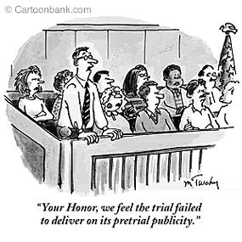
CRIMINAL TRIAL PROCEDURE

Slide 27
NOTE: FACTSHEETS/FORMS
MAGISTRATES:
http://www.magistratescourt.wa.gov.au/_apps/DocList/doclist.aspx
DISTRICT:
http://www.districtcourt.wa.gov.au/C/criminal_procedure_forms.aspx?uid=5639-9347-2826-1067
http://www.districtcourt.wa.gov.au/C/civil_procedures_forms.aspx?uid=4070-8317-1311-6503
SUPREME:
http://www.supremecourt.wa.gov.au/C/civil_forms.aspx?uid=2619-2020-2938-4465
http://www.supremecourt.wa.gov.au/C/criminal_forms.aspx?uid=2895-1783-5043-9417

Slide 28
FULL TRIAL PROCESS
Formal arrangement and plea
Jury empanelled
Prosecution outlines case (opening statement)
Defence outlines case (opening statement)
Witnesses are called:
Prosecution presents witnesses for examination-in-chief
Defence cross-examines prosecution witness
Prosecution may re-examine
No further questions
That concludes the case for the State
Defence presents witnesses for examination-in-chief
Prosecution cross-examines defence witnesses
Defence may re-examine witnesses

Slide 29
FULL TRIAL PROCESS
Prosecution summarises case
Defence summarises case
Judge addresses jury on law and facts of case
Jury retires to consider verdict (must be beyond reasonable doubt)
If ‘guilty’ = remanded until sentencing (conviction)
If ‘not-guilty’ = free to go (acquittal)
Sentencing by Judge
Appeals

Slide 30
RULES OF EVIDENCE
The presiding judge decides whether evidence is admissible or not
Appeals are often based on the admission or exclusion of particular evidence
Major rules of evidence:
Relevance
Privilege (lawyer/client; doctor/patient privilege)
Hearsay evidence
Similar fact evidence (previous convictions) Note: can be at sentencing
Corroboration (i.e. children need to be corroborated)
The right to remain silent

Slide 31
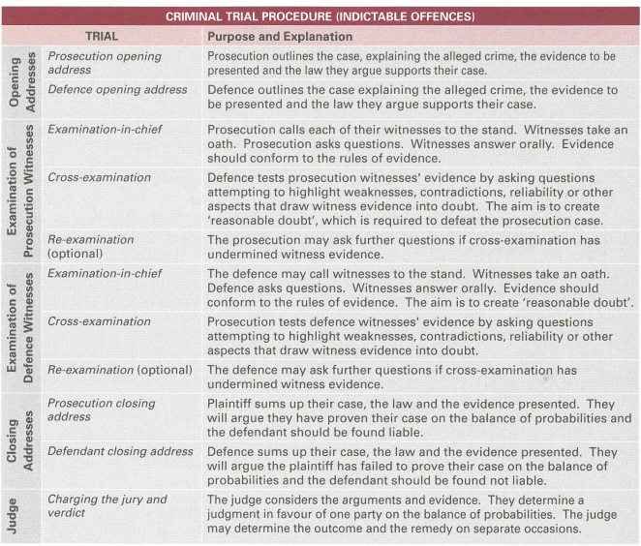

Slide 32
Post-trial procedure
CRIMINAL

Slide 33
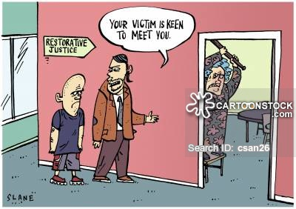
CRIMINAL POST-TRIAL
The aim of criminal sanctions:
Retribution
Deterrence
Rehabilitation
Protection
Restorative Justice

Slide 34
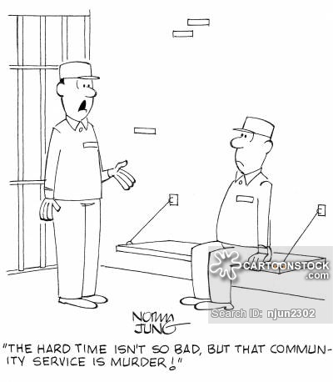
CRIMINAL POST-TRIAL
Types of Criminal Sanctions:
Custodial (prison)
Suspended custodial sentences (on the provision…)
Community work orders (replaced short jail time)
Fines
Bonds (bond of good behaviour)
Home detention

Slide 35
SENTENCING FACTORS?
Judges consider 2 things when sentencing:
Degree of criminality – how serious was the offence? What was the impact on the victim? Impact on community?
The offender – repeat or first offence? Mitigating and Aggrevating circumstances considered. Remorseful? Do they have dependants?

Slide 36
Overview

Slide 37
QUESTIONS…
Why do the majority of criminal and civil matters not proceed to trial?
Civil = 2 parties are required to attend mediation as part of the pre-trial process. Therefore, settlement is often reached through ADR
Criminal = the accused pleads guilty or the State discontinues charges before it reaches trial

Slide 38
COST PER CASE
Court Cost Per Case | 2019/20
Supreme Court-Criminal-Cost per case
Supreme Court-Civil-Cost per case
District Court-Criminal-Cost per case
District Court-Civil-Cost per case
Magistrates Court-Criminal-Cost per case
Magistrates Court-Civil-Cost per case
Complete this table. Google Department of Attorney-General Annual Report 2019/20 PDF Full Report
Scan Key Performance Indicators (pg. 183 of Dot AG Annual Report)
The cost per case is calculated by dividing the total cost of the jurisdiction by the number of cases finalised

Slide 39
Why is it higher for criminal cases?
States role is to prosecute all State criminal matters and this would add a significant cost in comparison to civil matters in which the 2 parties facilitate their own legal representation
The standard of proof in criminal matters may also be a contributing facto, significantly more evidence would be required in criminal matters as it is harder to reach the standard of beyond reasonable doubt.

Slide 40
